Slide 1
Shipping Truck Simulation
Daniel Craig
7/16/23

Slide 2
Context, Problem, and Significance
Context: Simulating the shipping processes at Kioti (Daedong-USA, Inc.)
Volume of truck shipments per day is highly variable, resources and processes allocated need to be appropriate for both low and high volume days
Truck waiting time incurs expenses for ‘Holding Fees’, this needs to be minimized
Kioti is a less-optimized, but rapidly growing company
Goods shipped consist of tractors (heavy machinery) and attachments
This does not include parts or receiving processes

Slide 3

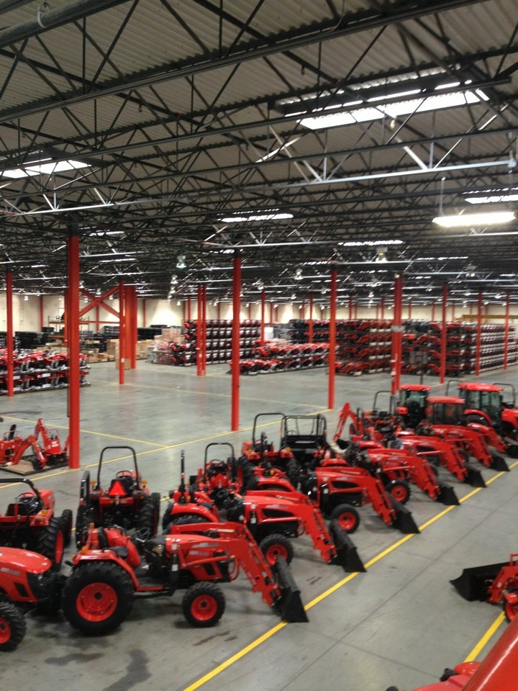
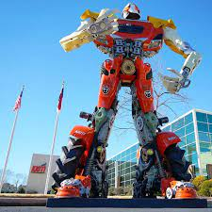
Kioti Warehouse + Area

Slide 4
Problem and Significance
Problem: Simulating the shipping processes at Kioti (Daedong-USA, Inc.)
Problem: How well can Kioti processes accommodate the variable load of shipping trucks to support anticipated sales?
Significance: As Kioti pushes for higher yearly sales, simulating future daily shipping volumes will inform management of what department changes need to be made. This may be process changes, different business relations contracts, changes in workforce

Slide 5
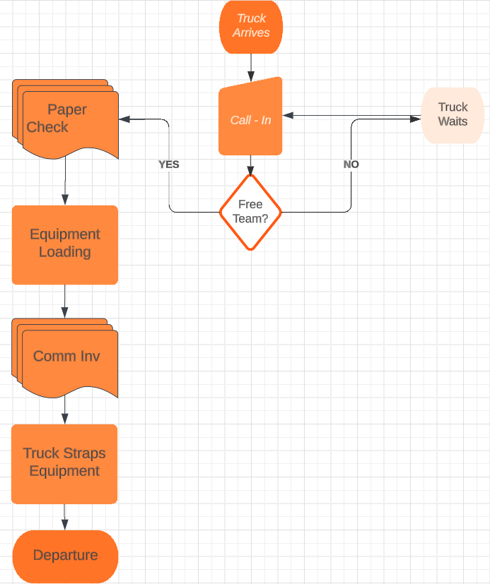
Process Flow
Truck arrives and calls in. During call-in a team is checked for availability.
If no team is available the truck is given a waiting number and is called once a team becomes available with an estimated waiting time.
Papers to confirm which load are checked.
Equipment is loaded.
Commercial Invoice and Bill of Lading is exchanged.
Truck straps equipment on outside of bay and departs

Slide 6
Simulating the Process
Primary Parameters: Number of Teams, Number of Trucks
Intended to change via user selection
Constants: Each constant below is technically a range of values where one value is randomly selected from the range
Check-In Duration (5 - 15 min)
Paper Duration Check (5 - 15 min)
Commercial Invc/BOL Exchange (5 - 15 min)
Loading Equipment (30 - 60 min)
Truck Strapping (30 - 60 min)
Constants were chosen by collaborating with Shipping Manager and Team Leads

Slide 7
How It Simulates
The program is simulating an entire day in which trucks arrive at random times between 8am - 5pm.
Trucks are “scheduled”, but rarely come even within 2 hours of their time
Arrival times are generated between 8am - 5pm
Arrival time and team availability are the two determinants that the process simulates over
One day of simulation ranges from 10 to 25 trucks.
Reasons for adding time of day:
Creates waiting time scenario if multiple trucks arrive at once
Allows for future parameterization of the program (i.e. what if all the trucks arrived after 10am?)

Slide 8
Why Simulate This Way?
Due to a combination of desires from the Shipping Manager and the intended extension of the program, the program needed to be setup so that future parameters could be accommodated:
Number of bays
Number of teams
Include receiving trucks & teams
Number of strap-down stations
Operational hour changes
There were also specific natures/scenarios that needed to be answered:
If 3 trucks arrive at 4:30pm, when does our team get to leave?
At exactly what time can I expect a truck to depart if it arrives at this time?
How well does our process handle 4 trucks at the same time?

Slide 9
Simulations Chosen & Validation
Two sets of simulations were chosen for class
10 to 30 Trucks & 2 Teams
10 to 30 Trucks & 3 Teams
In total, that is simulating 200 trucks. These parameters were chosen to show impact of potentially increasing manpower to accommodate more trucks in lieu of growing sales goals.
Validation was performed by
Gathering ‘tribal’ knowledge from Team Leads
Discussing estimates on truck visit duration (this metric isn’t being tracked in the real world)
After showing results from simulations, both groups felt like duration of activities and total processing time was accurate. What is not clear is whether truck arrival times are accurately represented since the department does not track this in a readily accessible manner.

Slide 10
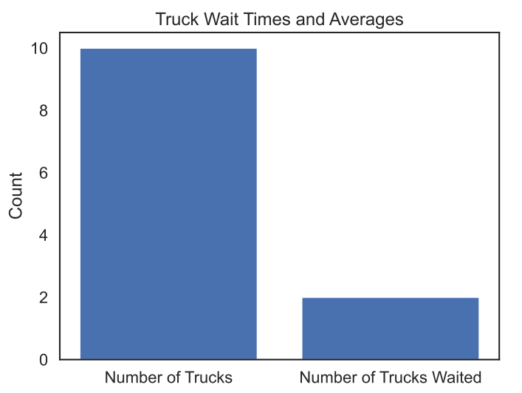
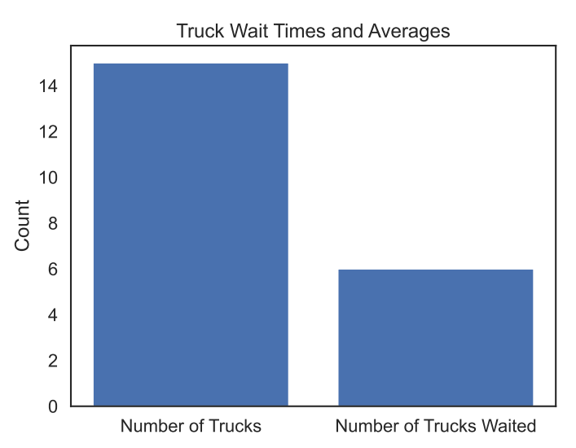
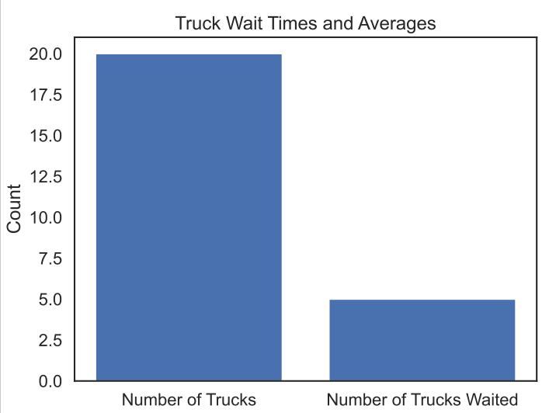
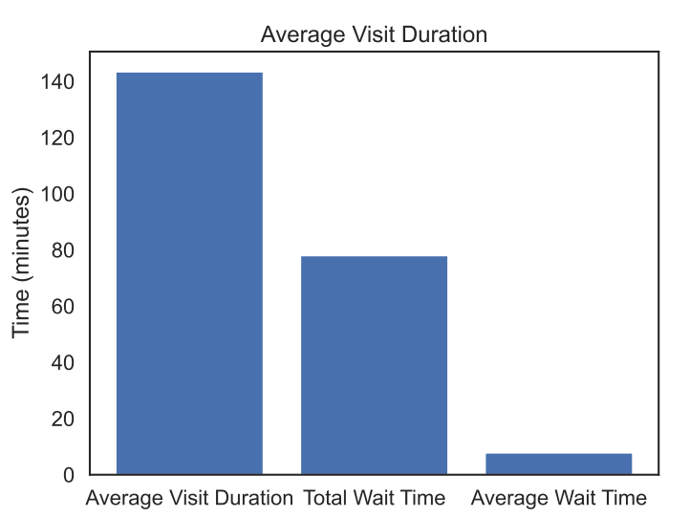
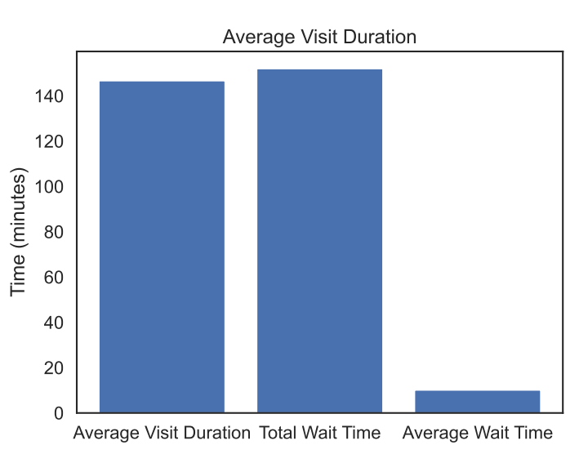
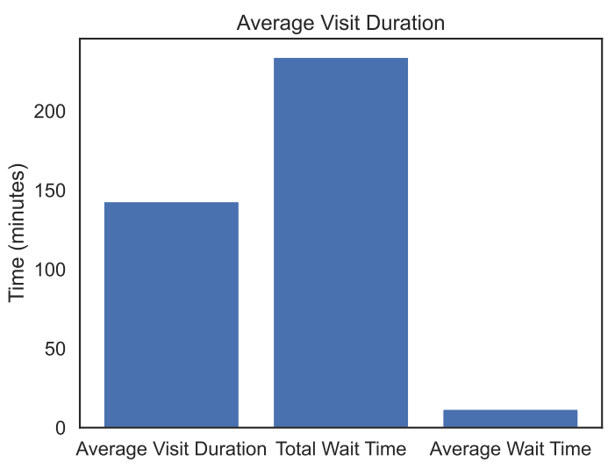
Findings: 2 Teams
10
15
20

Slide 11
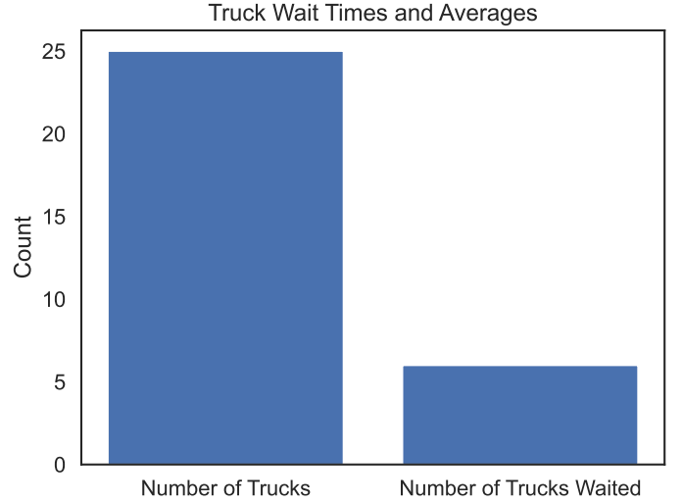
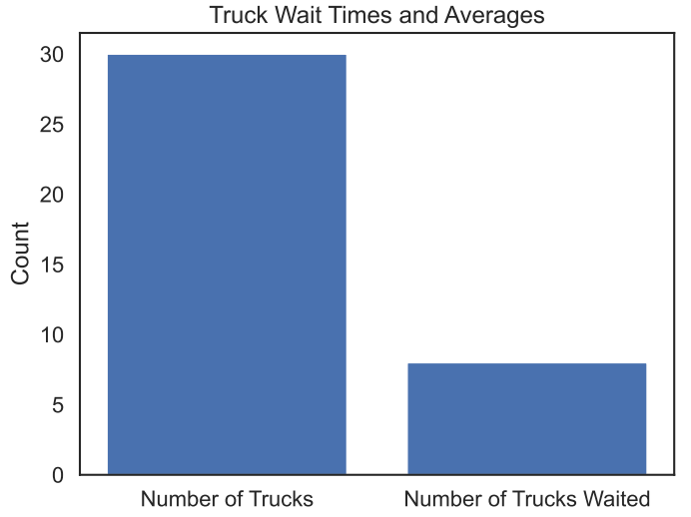
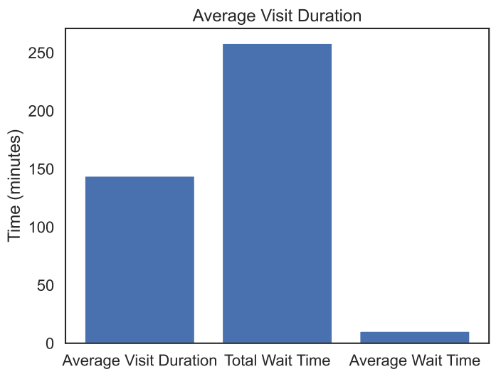
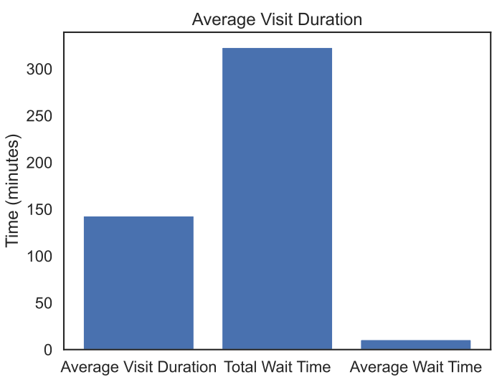
Findings: 2 Teams
25
30

Slide 12
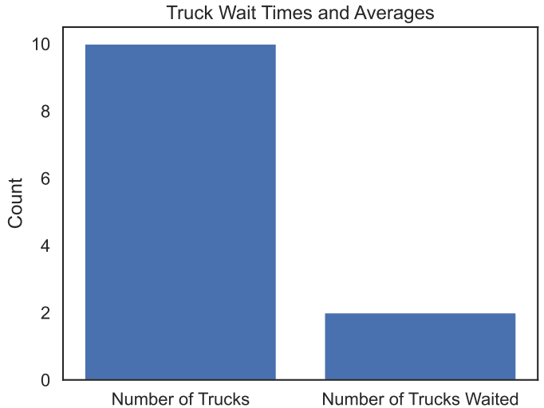
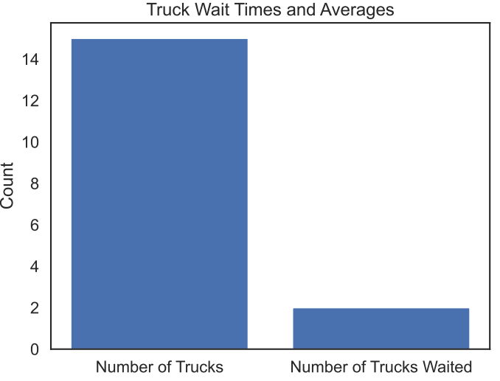
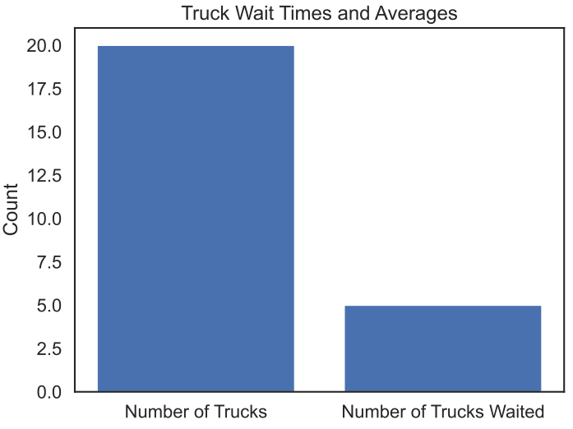
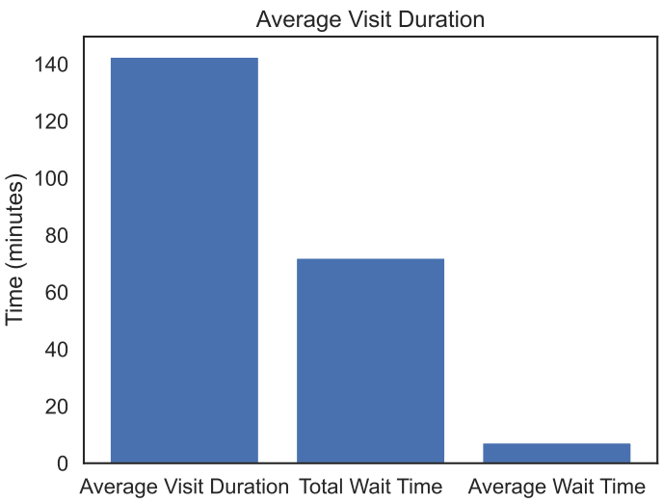
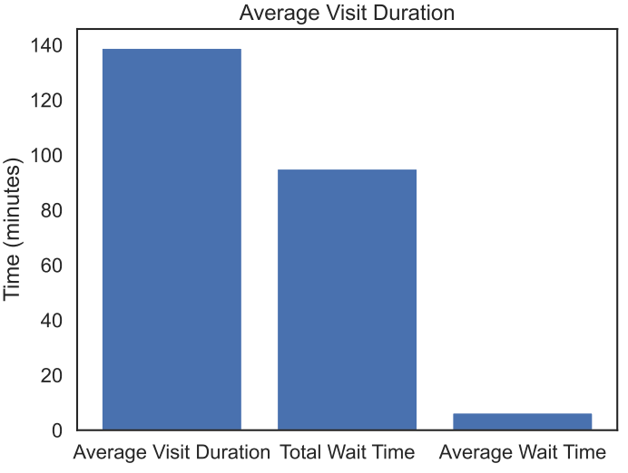
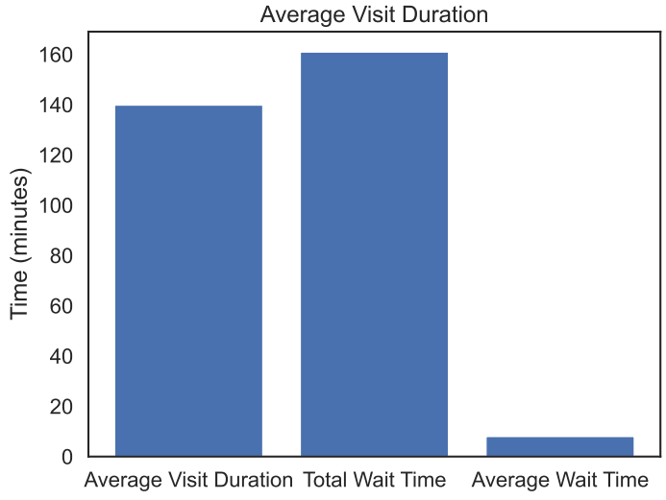
Findings: 3 Teams
10
15
20

Slide 13
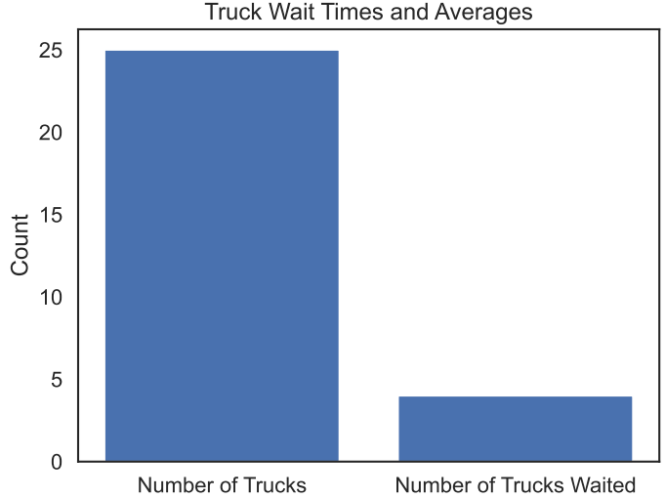

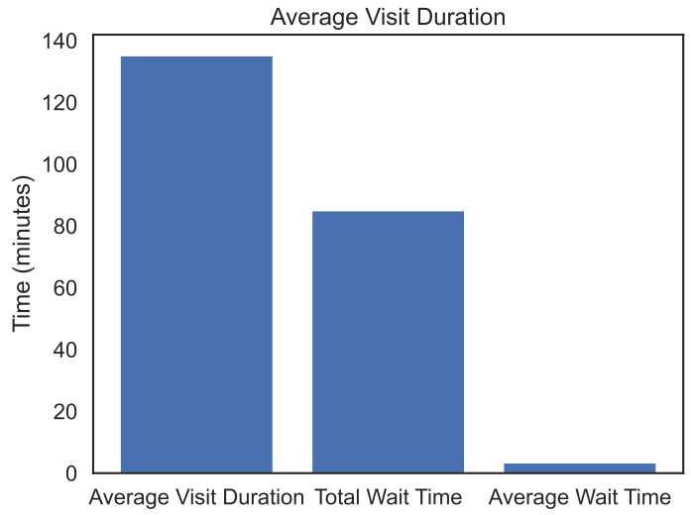
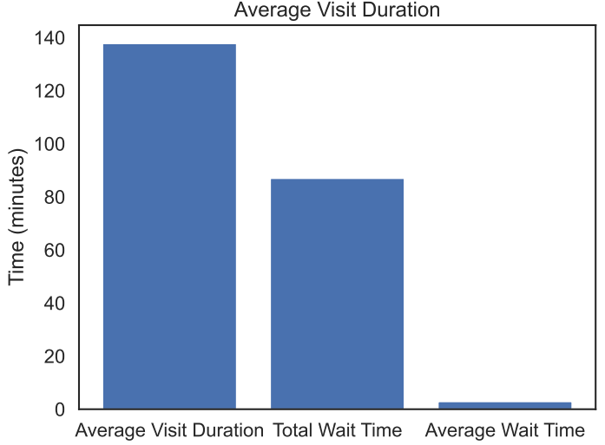
Findings: 3 Teams
25
30

Slide 14
Conclusions
In the current state of the model, it is accounting for truck arrival time being highly variable to reflect the current real world state. Internal process are relatively static, which with more investigation may not be the case after more research. The model has been built to maintain ease of expansion.
In both the 2 Team and 3 Team scenario, average wait time rarely increased
In both the 2 Team and 3 Team scenario, average visit duration increased slightly as more trucks were scheduled that day
Although it seems simple, the importance of truck arrival time shines. If 4 trucks all arrive at the same time, waiting time and potential subsequent back-log increase. Tracking and enforcing truck arrival time with similar “holding fees” should decrease trucks outside of scheduled times.

Slide 15
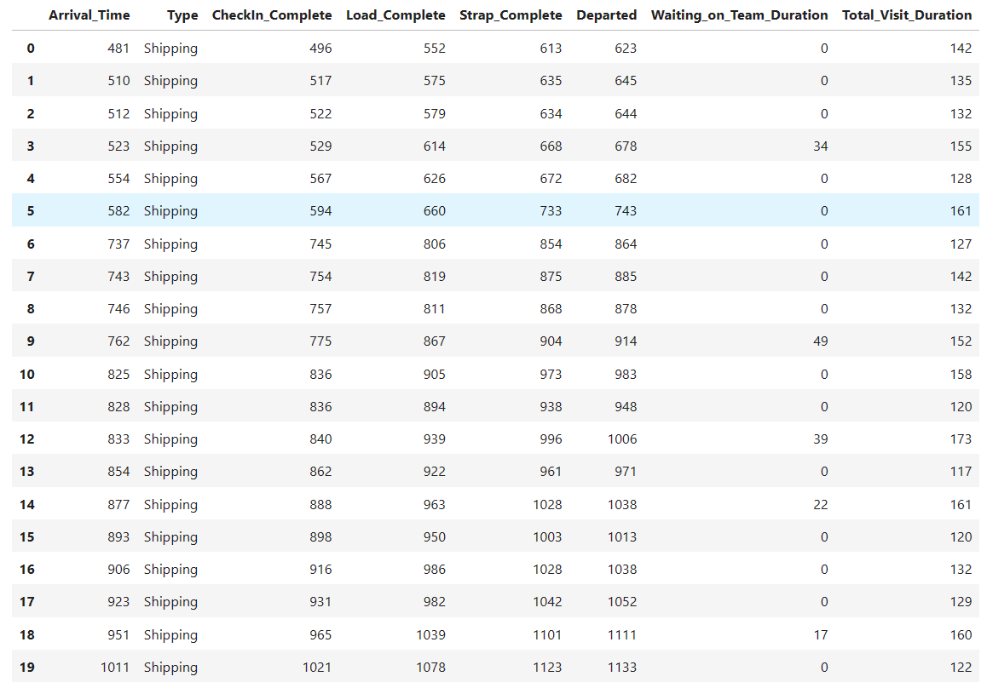
Appendix
Example of resulting dataframe with timestamps at each process to the right (times are in minutes, ie. 481 = 8:01am via 481/60
Code: DATA604/Final Project at main · d-ev-craig/DATA604 (github.com)
Please use view the warehouse_sim_Clean.ipynb jupyter notebook for using code. The other version may be continuously developed.

